Slide 1
Springworks Farm Study # 2
Windham Packaging, LLC
Gabriela Hernandez

Slide 2
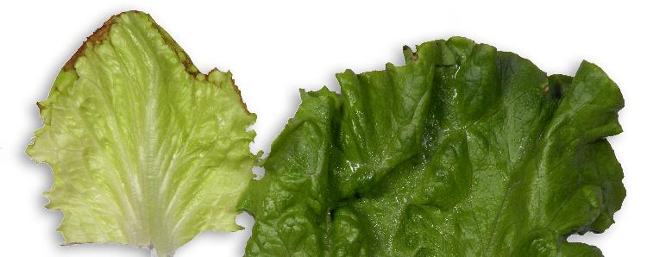
Summary and Conclusions
Weight loss was negligible in all samples (<0.01%) throughout the entire study
There were no major quality differences between samples kept inside the cartons and outside the cartons suggesting that the amount of venting in the cartons was adequate to get cooling.
There was a significant amount of tip burn present in the inner leaves of both the romaine and green leaf.
Tip burn in inner leaves is caused by calcium deficiency during growth and cannot be controlled by MAP.
Tip burn in outer leaves is caused by environmental factors during growth (i.e. insufficient water supply or too much salt near the roots)
Tip burn in inner (left) and outer leaf (right)

Slide 3
Summary and Conclusions
There was noticeably less browning in the stem during this study than the previous study, even in the green leaf samples kept in the Old OTR sleeves. Because there were no differences in the process, this can be attributed to natural variation in the pinking/browning enzyme. In the next study, a mixture of ascorbic and citric acid should be sprayed onto the butt end of the green leaf and baby romaine heads to see if browning is controlled.
The new OTR in the green leaf sleeves succeeded in extending shelf life. With these sleeves, we can achieve a shelf life of 17-19 days.
OTR1 (no perforations) caused anaerobic atmospheres inside the baby romaine bags and all samples were rotted before day 10. This is not a suitable bag for baby romaine.
Baby romaine OTR2 bags were more successful and extended shelf life to 14 days. We believe a higher O2 flux will further extend shelf life.
Additional testing should be done on the baby romaine comparing two different higher OTR bags.

Slide 4
Results and Discussion:
Internal Temperature
Visual Quality Throughout Shelf Life
Photos
Visual Comparisons and Presence of Defects among Samples
Shelf Life Studies

Slide 5
Internal Temperature – Green Leaf
Days in Storage | Product | Temperature Inside Bag (°F) | Temperature out of bag (°F)
7 | Green Leaf out of Carton - New OTR | 54.1 | 57.9
7 | Green Leaf out of Carton - Old OTR | 53.6 | 55.4
7 | Green Leaf in Carton - Old OTR | 54.9 | 55.9
7 | Green Leaf in Carton - New OTR | 53.6 | 55.8
10 | Green Leaf out of Carton - New OTR | 49.3 | 55.0
10 | Green Leaf out of Carton - Old OTR | 50.2 | Not Tested
10 | Green Leaf in Carton - Old OTR | 53.8 | 54.3
10 | Green Leaf in Carton - New OTR | 53.8 | 52.7
14 | Green Leaf out of Carton - New OTR | 48.2 | 52.7
14 | Green Leaf out of Carton - Old OTR | 49.5 | 50.7
14 | Green Leaf in Carton - Old OTR | 51.6 | 50.0
14 | Green Leaf in Carton - New OTR | 49.6 | 51.6
17 | Green Leaf out of Carton - New OTR | 46.8 | 52.5
17 | Green Leaf out of Carton - Old OTR | 45.7 | 50.9
17 | Green Leaf in Carton - Old OTR | 52.2 | 51.1
17 | Green Leaf in Carton - New OTR | 50.4 | 48.7
20 | Green Leaf in Carton - Old OTR | 60.2 | 55.9
20 | Green Leaf out of Carton - New OTR | 57.6 | 52.9

Slide 6
Internal Temperature – Baby Romaine
Days in Storage | Product | Temperature Inside Bag (°F) | Temperature out of bag (°F)
7 | Baby Romaine out of Carton - OTR 1 | 57.4 | 57.2
7 | Baby Romaine out of Carton - OTR 2 | 59.4 | 55.9
7 | Baby Romaine in Carton - OTR 1 | 57.7 | 55.4
7 | Baby Romaine in Carton - OTR 2 | 56.5 | 54.9
10 | Baby Romaine out of Carton - OTR 1 | 57.6 | 53.4
10 | Baby Romaine out of Carton - OTR 2 | 57.4 | 54.9
10 | Baby Romaine in Carton - OTR 1 | 57.2 | 51.3
10 | Baby Romaine in Carton - OTR 2 | 55.0 | 48.4
14 | Baby Romaine out of Carton - OTR 1 | 54.1 | 50.7
14 | Baby Romaine out of Carton - OTR 2 | 54.1 | 51.8
14 | Baby Romaine in Carton - OTR 1 | 52.5 | Not Tested
14 | Baby Romaine in Carton - OTR 2 | 53.8 | 48.6
17 | Baby Romaine out of Carton - OTR 2 | 52.9 | 50.9
17 | Baby Romaine in Carton - OTR 2 | 56.5 | 48.4

Slide 7
Headspace Levels in Green Leaf
Green leaf heads packaged in new OTR sleeves had slightly reduced O2 and increased CO2 compared to the old sleeves
Reduced O2 and increased CO2 is known to extend shelf life in leafy greens. In this case, we believe that CO2 played a bigger role in extending shelf life because O2 levels in both OTR sleeves were very similar.
Average O2 was slightly lower and CO2 was higher when New OTR bags were placed inside the carton compared to outside the carton
Less oxygen was circulated inside the cartons, which is expected. However, it did not make a difference in quality.

Slide 8
Headspace Levels in Baby Romaine
Anaerobic conditions developed in OTR1 bags.
Anaerobic atmospheres (~0% O2) are undesirable because they can result in early decay, off odors, and growth of harmful bacteria
Baby romaine bags need to have higher OTRs to avoid these conditions
O2 in OTR2 bags fluctuated between 6 and 9%. This is due to normal changes in respiration during storage
CO2 in OTR2 bags was significantly lower than OTR1 bags. The elevated CO2 can help reduce red color development on the butt ends. However, too much CO2 accumulation can lead to injury and premature decay.

Slide 9
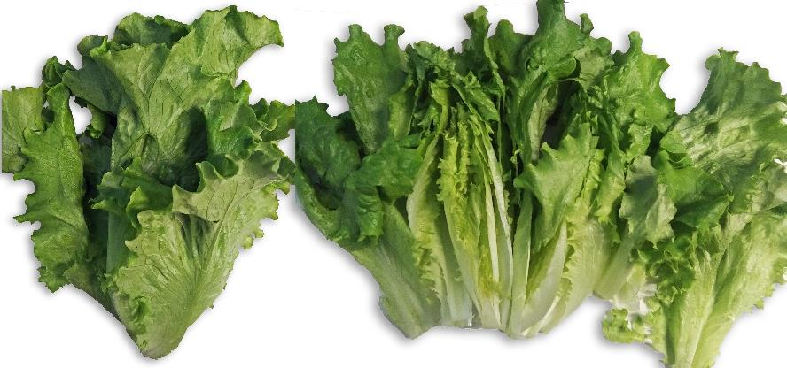
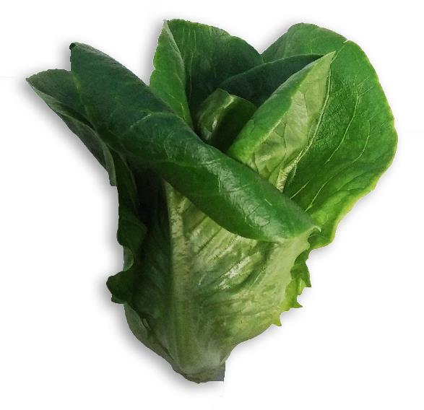
Visual Quality and Taste
Initial quality:
Green leaf
Leaves were green and crisp with no signs of mildew.
No tip burn visible
No spotting or wilting
Taste was fresh, no smell
Baby Romaine
Leaves were green and crisp
No signs of mildew
Slight tip burn on a couple of exterior leaves
Taste is fresh
Initial Green Leaf (top) and Baby Romaine (bottom)

Slide 10
Day 7
Green Leaf
Baby Romaine
Both green leaf samples had red/brown stems and some brown lesions near the stems
Taste was good, texture was crisp
No difference in visual quality between OTR1 and OTR2 bags
Some mold present in outer leaves and browning in ribs near the stems
Some rust spots began to form
Taste was good and fresh. Texture was crisp

Slide 11
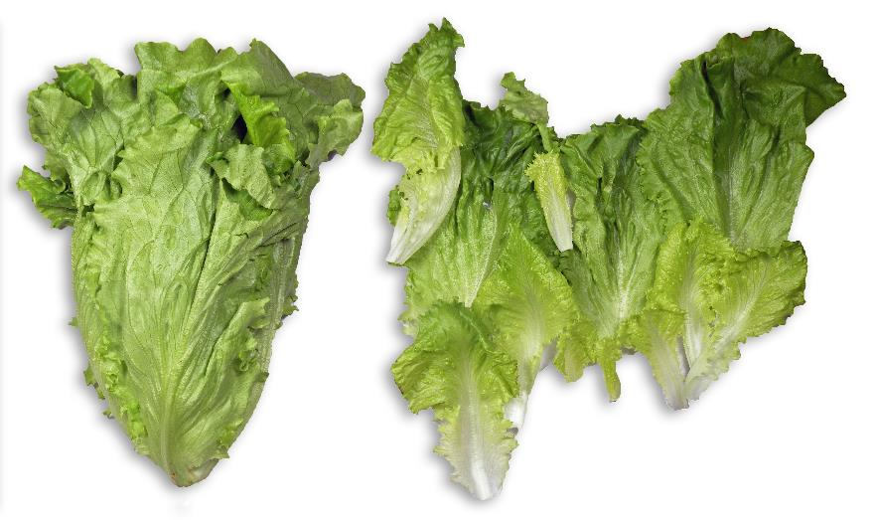
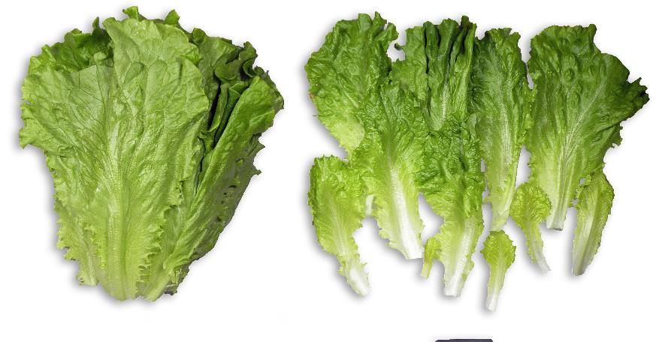
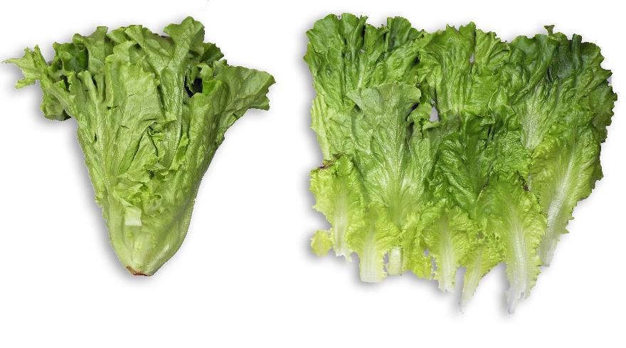
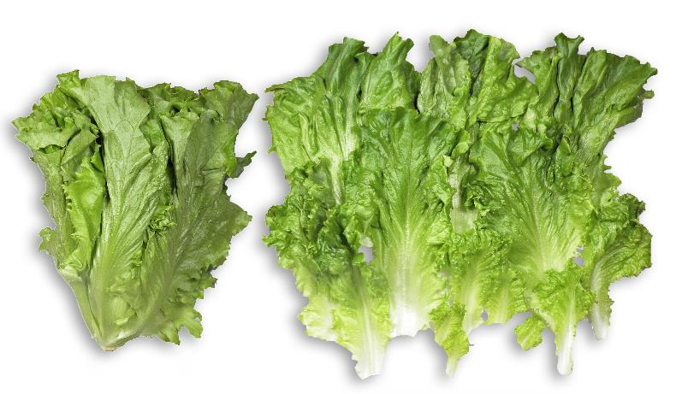
Day 7 Green Leaf in Old OTR Bag – out of Carton
Day 7 Green Leaf in New OTR Bag – out of Carton
Day 7 Green Leaf in Old OTR Bag – inside Carton
Day 7 Green Leaf in New OTR Bag – inside Carton

Slide 12
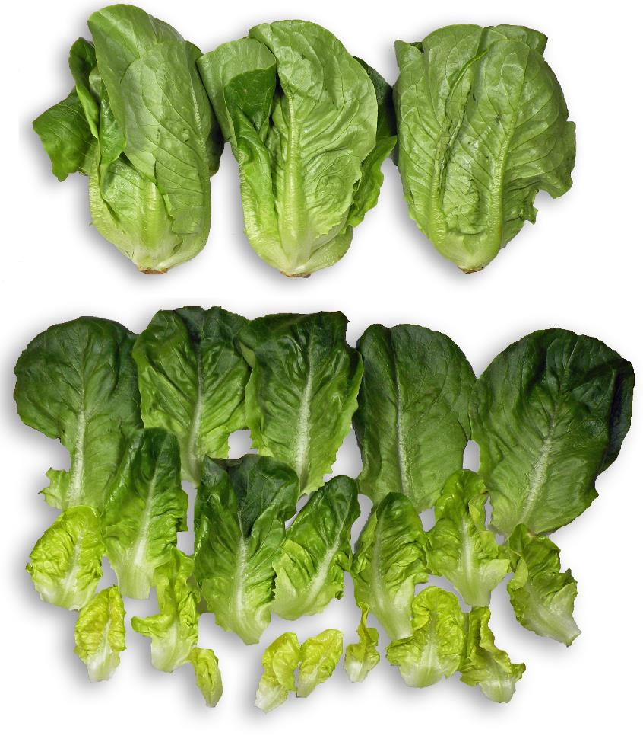
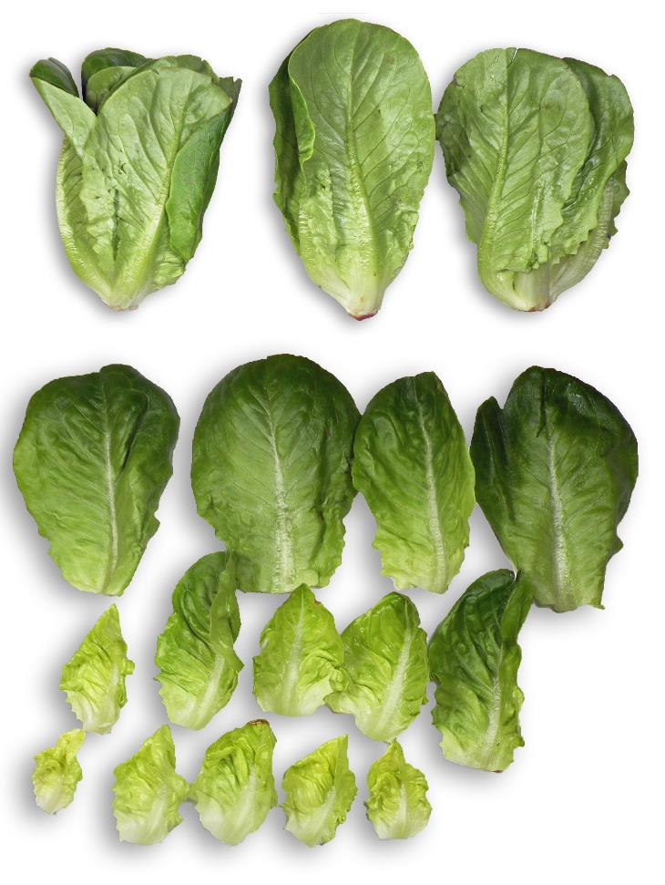
Day 7 Baby Romaine in OTR1 Bag – inside Carton
Day 7 Baby Romaine in OTR1 Bag – out of Carton

Slide 13
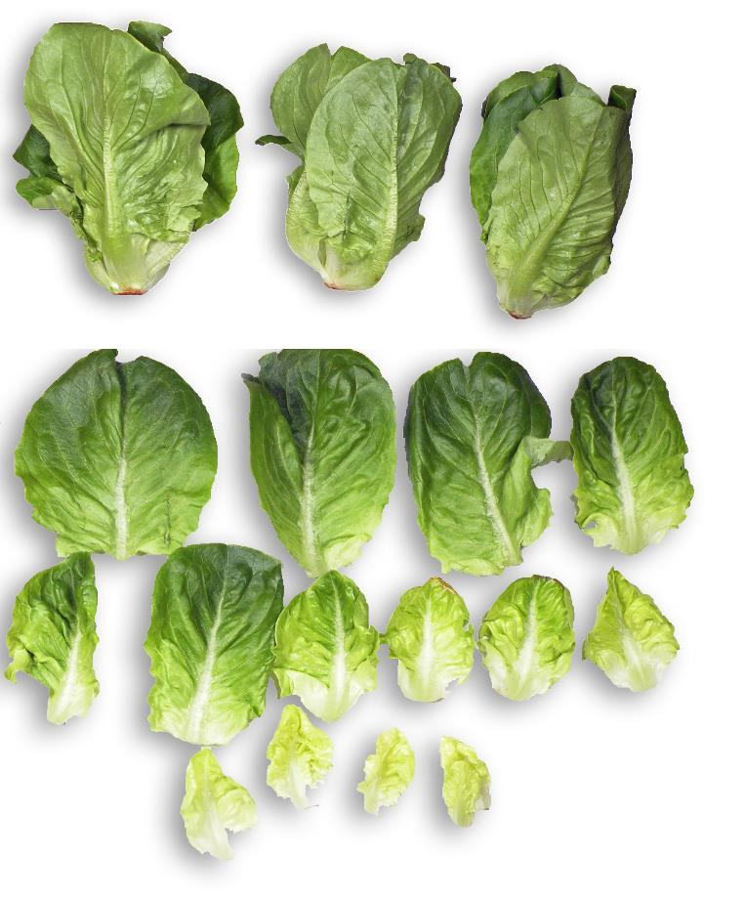
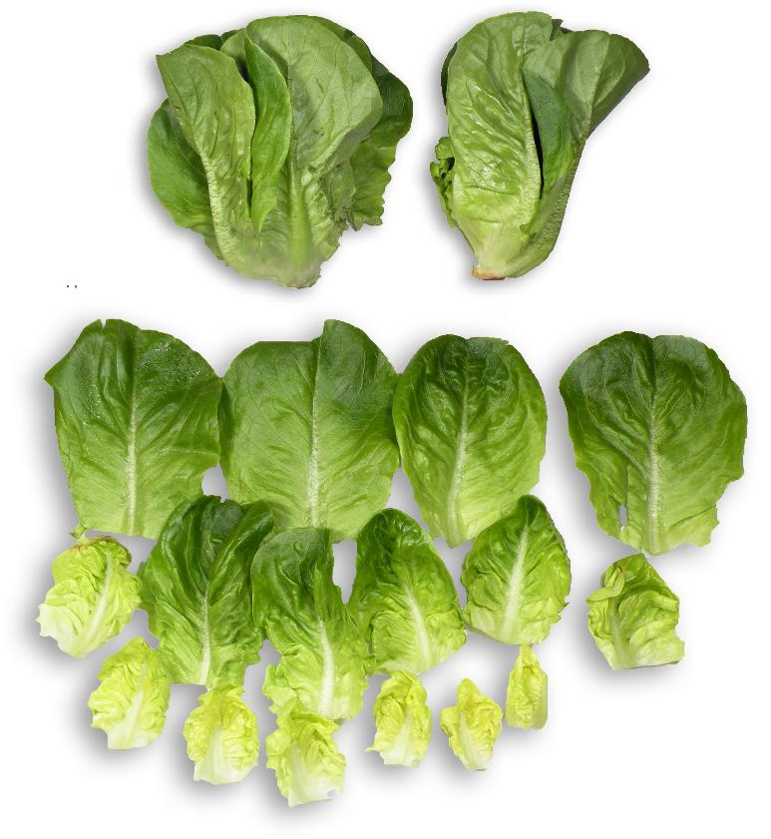
Day 7 Baby Romaine in OTR2 Bag – out of Carton
Day 7 Baby Romaine in OTR2 Bag – inside Carton

Slide 14
Day 10
Green Leaf
Baby Romaine
New OTR Sleeves:
Some rust spots in outer leaves
Taste was good; fresh
Old OTR Sleeves:
1 outer leaf had severe rust spots and decay
2 outer leaves had minor rust spots
Taste was good; fresh
OTR1 Bags
All samples were decayed, wet, and had an off-odor
Final test day for OTR1 samples. OTR1 is not a good choice for baby romaine.
OTR2 bags
Decay due to mechanical damage in some outer leaves
Some rust spots in outer leaves
Taste good; fresh. Leaves were crisp.

Slide 15
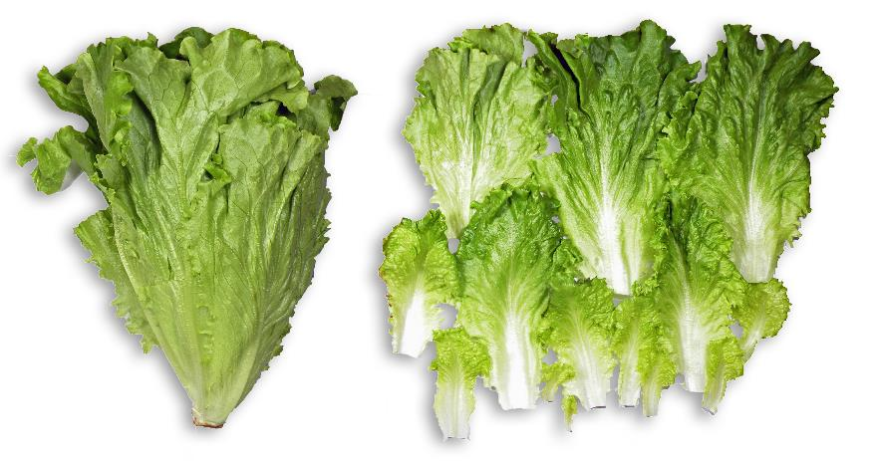
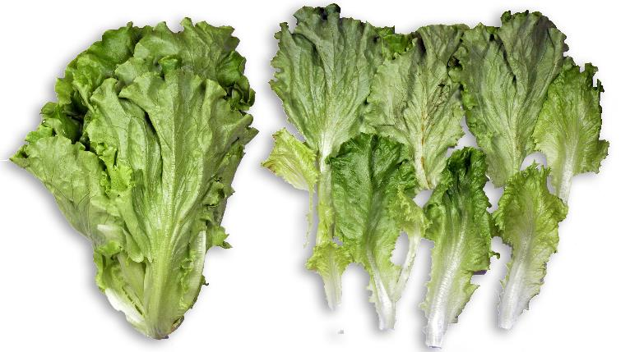
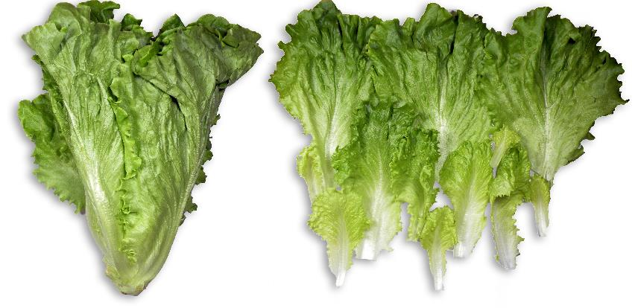
Day 10 Green Leaf in Old OTR Bag – out of Carton
*Not pictured. Not opened due to not enough samples
Day 10 Green Leaf in New OTR Bag – out of Carton
Day 10 Green Leaf in Old OTR Bag – inside Carton
Day 10 Green Leaf in New OTR Bag – inside Carton

Slide 16
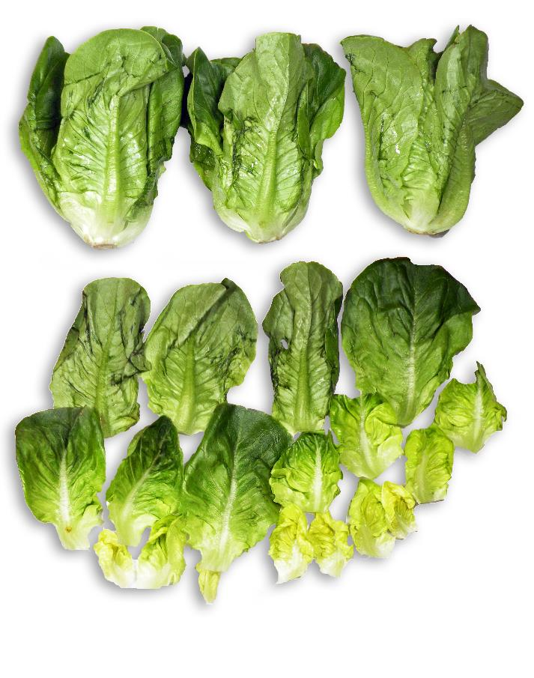
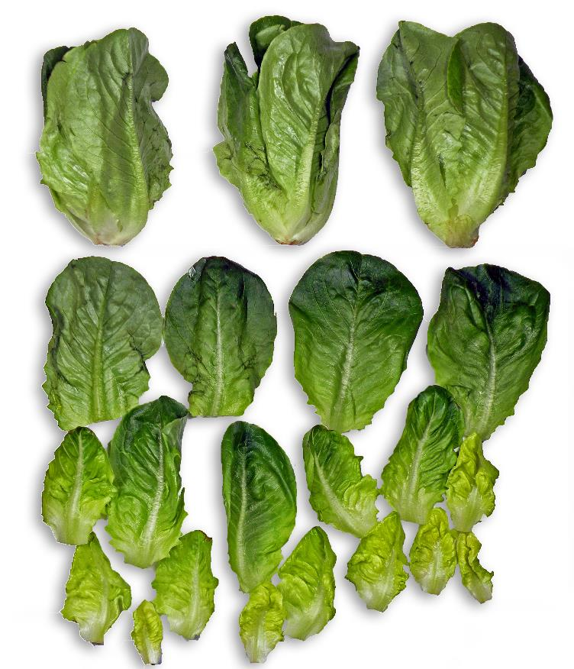
Day 10 Baby Romaine in OTR1 Bag – out of Carton
Day 10 Baby Romaine in OTR1 Bag – inside Carton

Slide 17
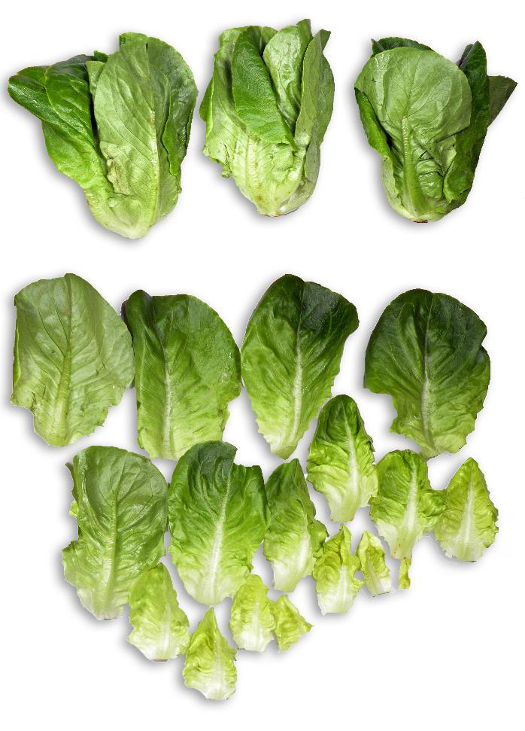
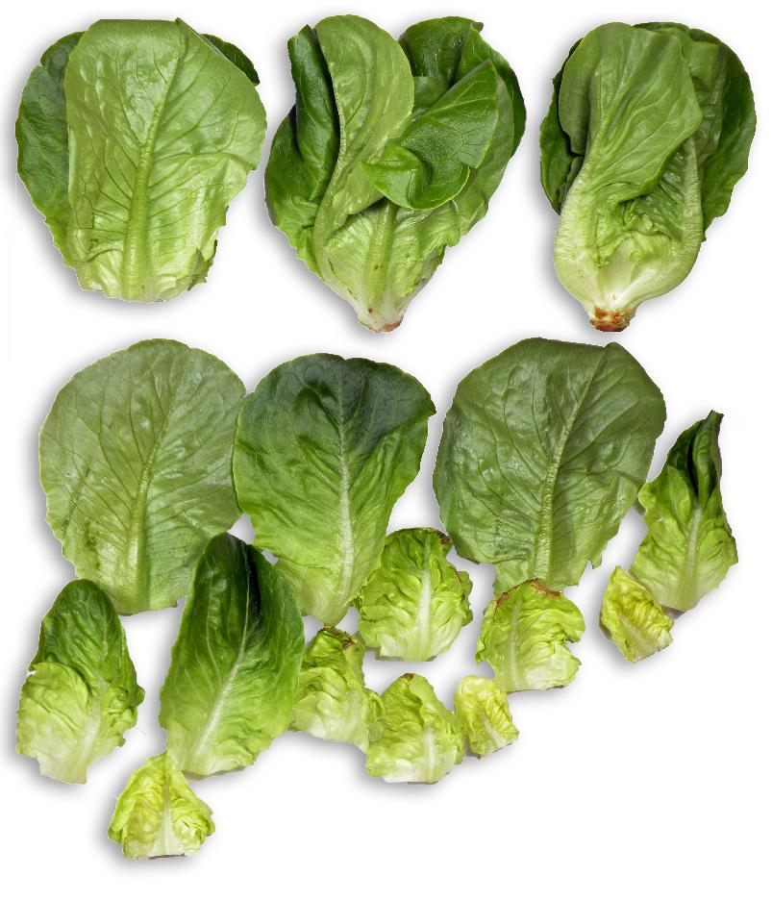
Day 10 Baby Romaine in OTR2 Bag – out of Carton
Day 10 Baby Romaine in OTR2 Bag – inside Carton

Slide 18
Day 14
Green Leaf
Baby Romaine – OTR 2 Bags
New OTR Sleeves:
Some mold present in outer leaves
Minor rust spots
Taste was good; fresh. Texture was crisp
Old OTR Sleeves:
2 outer leaves had mold/mildew
Taste was ok, but not as good as green leaf samples in New OTR sleeves
Some samples had mechanical damage-related decay in the outer leaves
3 leaves had rust spots
Taste was good and texture was crisp

Slide 19
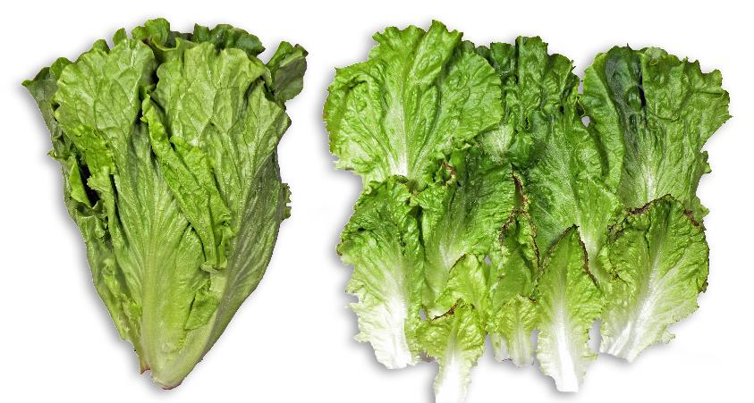
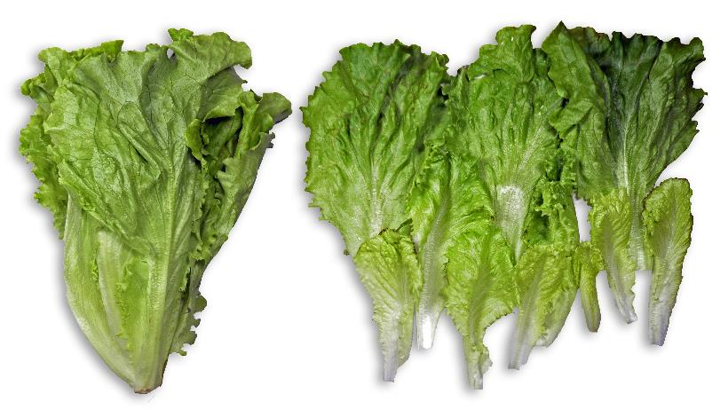
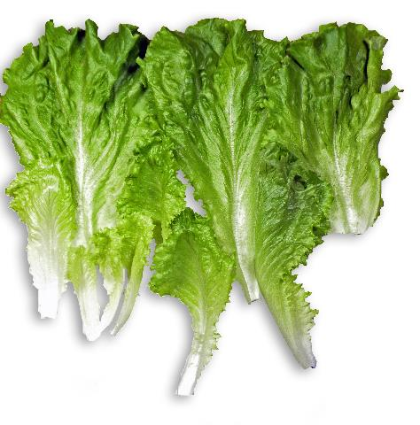
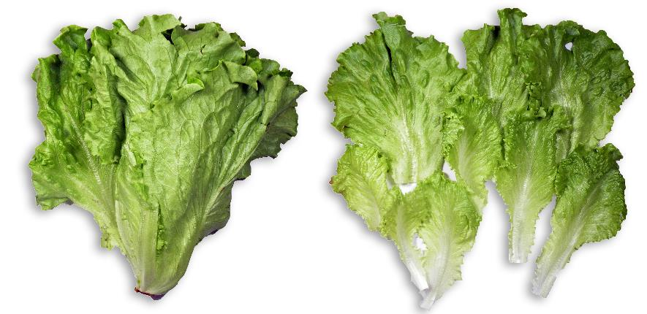
Day 14 Green Leaf in Old OTR Bag – out of Carton
Day 14 Green Leaf in New OTR Bag – out of Carton
Day 14 Green Leaf in Old OTR Bag – inside Carton
Day 14 Green Leaf in New OTR Bag – inside Carton

Slide 20
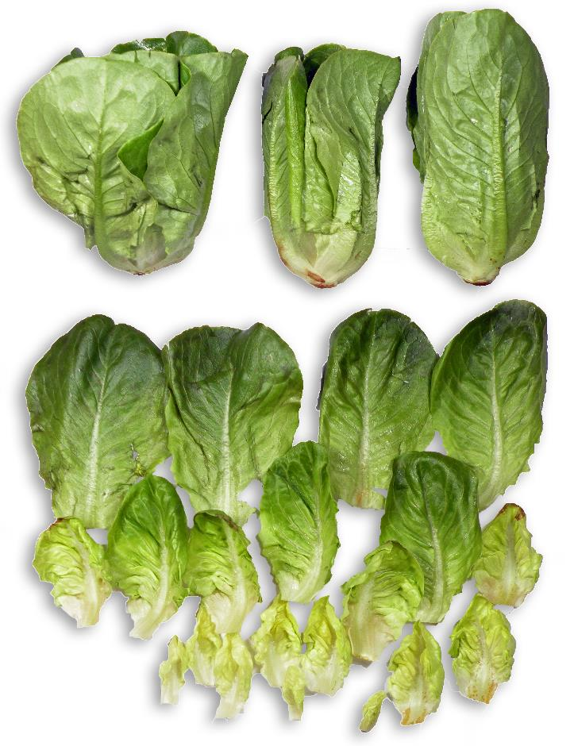
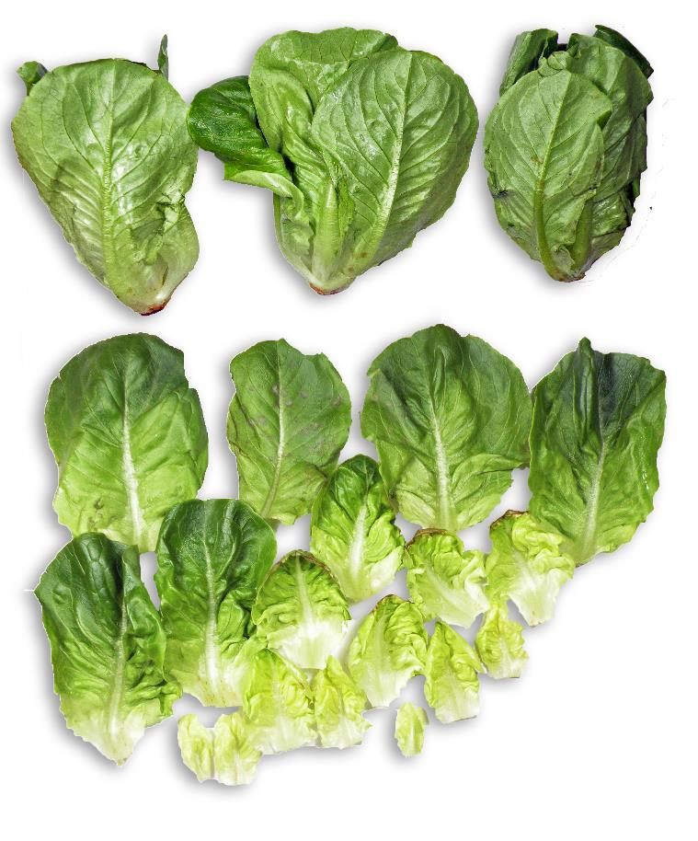
Day 14 Baby Romaine in OTR2 Bag – out of Carton
Day 14 Baby Romaine in OTR2 Bag – inside Carton

Slide 21
Day 17
Green Leaf
Baby Romaine – OTR 2 Bags
New OTR Sleeves:
Rust spots in 3 outer leaves
Taste was good, sweet, and fresh. Texture was crisp.
Old OTR Sleeves:
1 outer leaf had mold/mildew
Rust spots were present in some outer leaves
Taste was ok, but not as good as the green leaf in the new OTR sleeve
Some samples were decayed and had an off-odor
Mold present in 2 outer leaves
Taste was good
End of shelf life

Slide 22
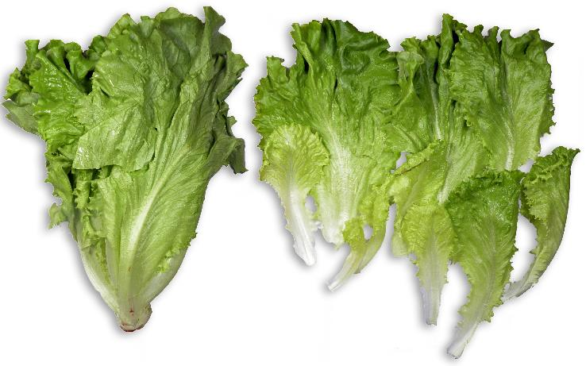
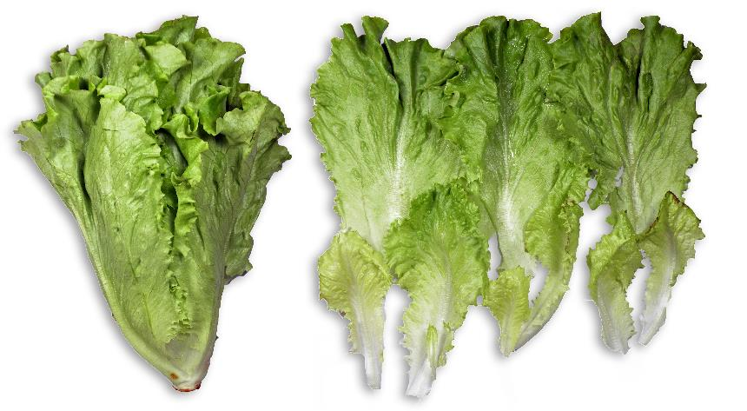
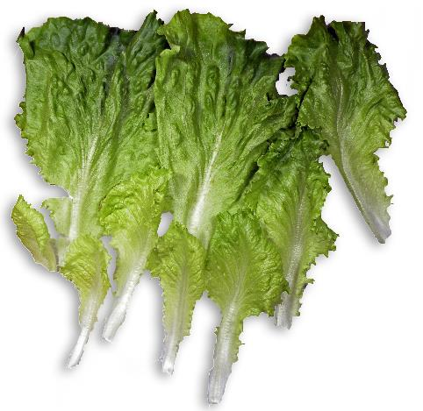
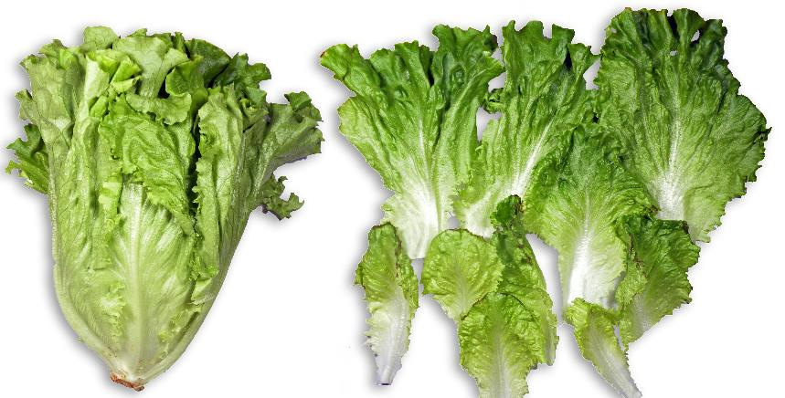
Day 17 Green Leaf in Old OTR Bag – out of Carton
Day 17 Green Leaf in New OTR Bag – out of Carton
Day 17 Green Leaf in Old OTR Bag – inside Carton
Day 17 Green Leaf in New OTR Bag – inside Carton

Slide 23
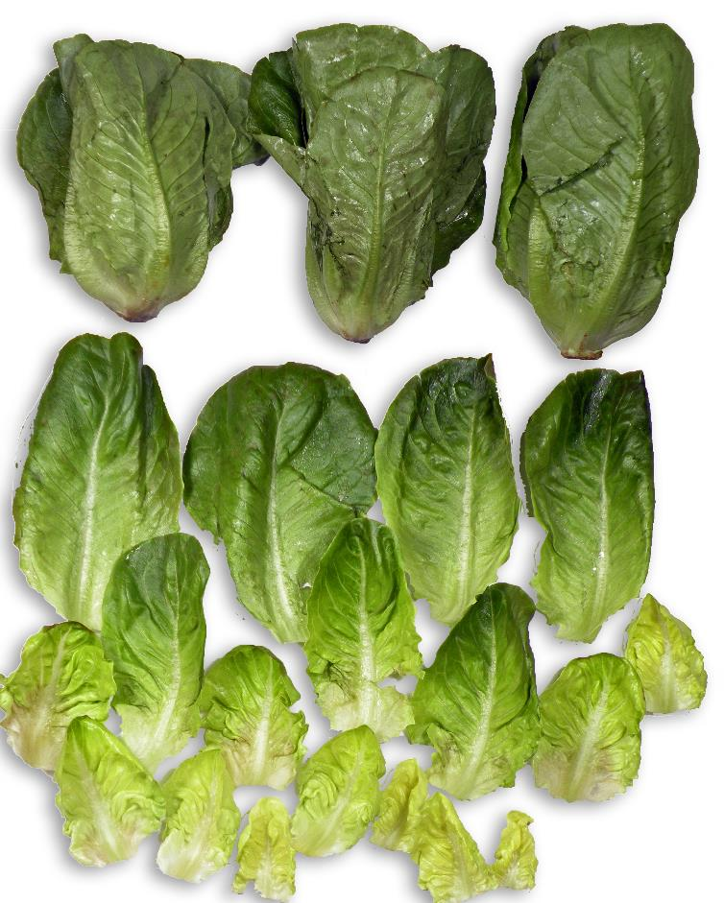
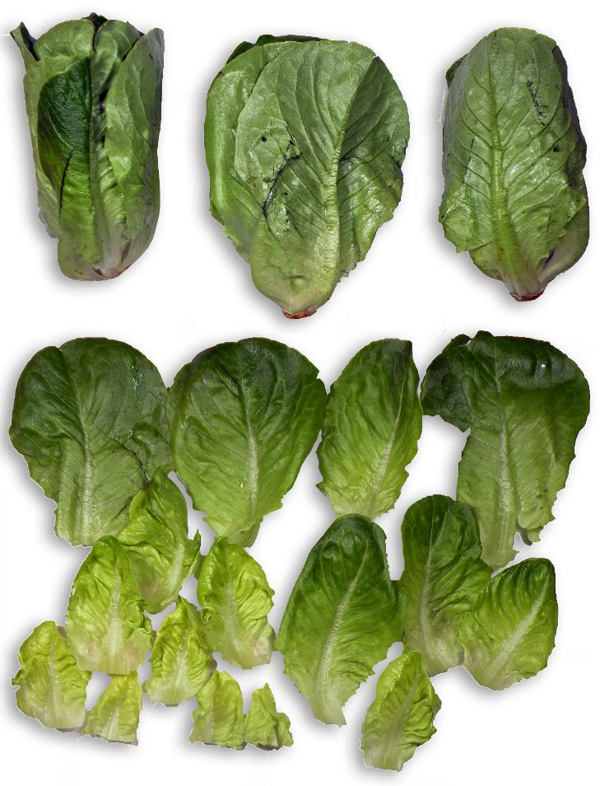
Day 17 Baby Romaine in OTR2 Bag – out of Carton
Day 17 Baby Romaine in OTR2 Bag – inside Carton

Slide 24
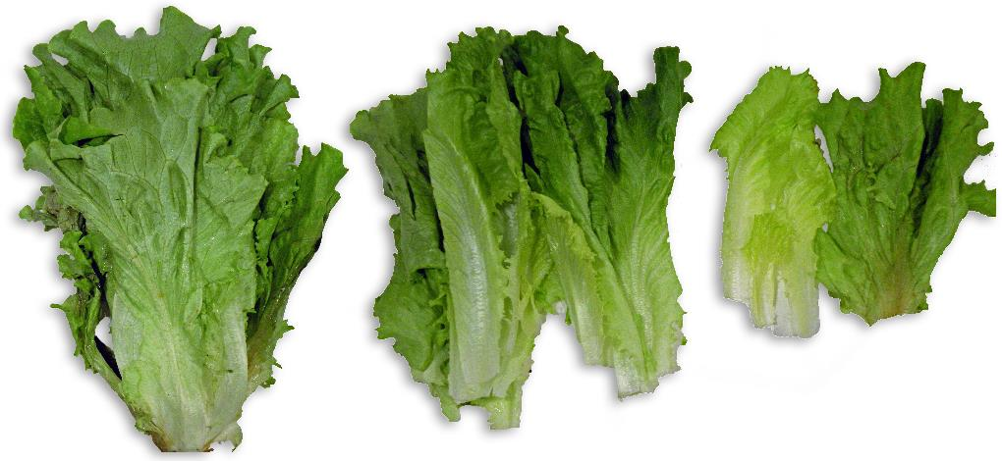
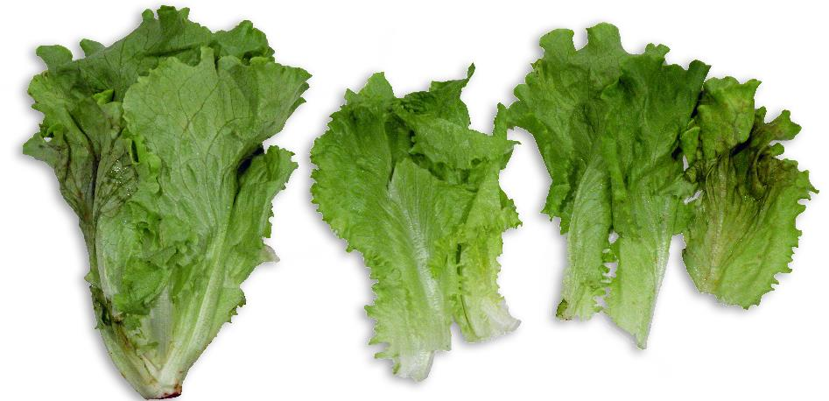
Day 20 Green Leaf
There was variability in all of the samples
New OTR Sleeves:
1 outer leaf was decayed
1 stem was decayed
Taste was sweet, texture was crisp
Old OTR Sleeves:
1 to 3 outer leaves had mold/decay
Taste was ok, but not as good as the green leaf in the new OTR sleeve
Day 20 Green Leaf in New OTR Bag – out of Carton
Day 20 Green Leaf in Old OTR Bag – inside Carton

Slide 25
Materials and Methods
Baby romaine and green leaf heads were grown and harvested on 1/28/19 at Springworks Farm at 70°F. The harvested product was moved to a cooler (34-36°F) and cooled for at least 30 minutes.
The harvested product was moved to a cooler (34-36°F). Baby romaine was packaged in Windham Packaging MAP bags (OTR 1 and OTR 2). Green leaf was packaged in sleeves with the original OTR from the previous study and sleeves with a new OTR (lower O2 flux rate). The product was packaged in the cooler and held at 34-36°F for 3 days.
The samples were packaged into vented, cooled cartons and transported to the laboratory at Windham Packaging, Windham, NH.
Packages were stored at 45-50°F for 4 days, then moved to 40-42°F for the remainder of the study.

Slide 26
Procedures: Quality Testing
Weight was checked on days 0, 7, 10, 14, 17, and 20 using a digital scale
Expressed as weight loss (%)
Quality observations such as decay, yellowing, mold/mildew, mechanical damage, stem color, browning, taste and off-odor were observed.
Temperature of lettuce was checked with an infrared thermometer while the product was both inside and outside of the bags.
Headspace readings inside packages were checked using a gas analyzer
Shelf life studies were done on each sample during each test day

